Slide 1

Hexaware CODE&RISE PROGRAM
THE X_Velammal_Inst
“Innovating Tomorrow, One Code at a Time”.

Slide 2
Team Details
Team Name : THE X_Velammal_Inst
Application Name: Assesment Platform
Team Members
Email ID
Sheninth JR
Monesh S
Arun P
Deverchetty Chandra Shekar
sheninthjr@gmail.com
moneshshanmugam@gmail.com
arun.kadampuliyur@gmail.com
dreamc1807@gmail.com

Slide 3

Impact/Potential Value of the Application
Customization and Relevance
Prevention of outside-sourced malpractice
Equitable competition among participants;
Data protection and confidentiality
AI observation
Shorten the administrative time when uploading exam questions.
Comprehensive Feedback and Analytics
Future-Proofing Assessment Practices
Long-Term Impact on Education and Workforce Development

Slide 4
Solution Highlights
Key Features / Approach
The Custom Question Upload System will have an easy-to-use interface with support for LaTeX and a rich text editor for multimedia formatting to facilitate the creation and management of different question kinds.
Bulk uploads with data validation and real-time error management will be supported. Questions will be categorized by topic and difficulty by NLP algorithms, with manual overrides and ongoing learning for increased accuracy.
To guarantee secure examinations, the AI proctoring system will have sophisticated capabilities like motion analysis, gaze tracking, and extension blocking.
It will give teachers thorough feedback and analytics so they can improve learning results and adjust to the demands of the job
Students will be able to use a SWOT analysis tool to identify strengths, weaknesses, opportunities, and threats in their learning process. It will also provide extensive student performance metrics, allowing for tailored feedback and targeted improvements.
Custom Question Upload System
Bulk Uploads
Categorization
AI Proctoring System
extension blocking
Motion analysis
gaze tracking
Feedback & Analytics
Student Tools
SWOT Analysis
Performance Metrics

Slide 5
Technologies Used
Frontend Technologies
HTML5
CSS3
JavaScript
React or Angular
Rich Text Editor
TinyMCE
LaTeX Support (MathJax or KaTeX)
Backend Technologies
Node.js
RESTful APIs
Text Classification
Hugging Face Transformers
Computer Vision and AI
OpenCV
Dlib
TensorFlow
Security Solutions
Custom-built Extensions or Existing Security Solutions
Data Visualization and Analytics
Power BI
D3.js
Databases
PostgreSQL
MongoDB

Slide 6
Gen AI Tool Utilization
GPT-4 (OpenAI)
Purpose: To generate sample questions, educational content, and detailed feedback.
Hugging Face Transformers
Purpose: For natural language processing tasks like text classification, summarization, and question categorization.
OpenAI Codex
Purpose: To automate question creation and formatting, and integrate with LaTeX for mathematical content.
IBM Watson
Purpose: For advanced NLP, machine learning, and data analysis to assist with content analysis and error detection.
TensorFlow
Purpose: To develop and deploy machine learning models for analyzing proctoring data and enhancing system functionality.
OpenCV
Purpose: For motion analysis and image processing in the AI proctoring system.
Dlib
Purpose: To assist with facial recognition and gaze tracking for the AI proctoring system.
PostgreSQL or MongoDB
Purpose: For reliable database management, storing questions, user data, and metadata.
Node.js
Purpose: To handle backend server operations and API interactions for both systems.
TinyMCE
Purpose: For rich text editing and LaTeX support in the Custom Question Upload System.
Power BI or D3.js
Purpose: For creating and visualizing performance metrics and analytics dashboards.

Slide 7
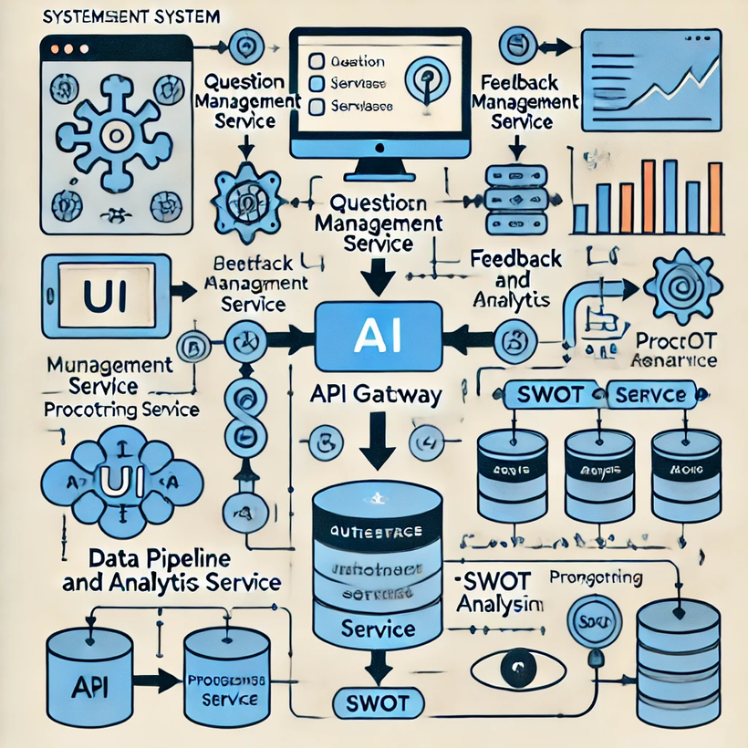
System Architecture, Functionalities and Design Diagram

Slide 8
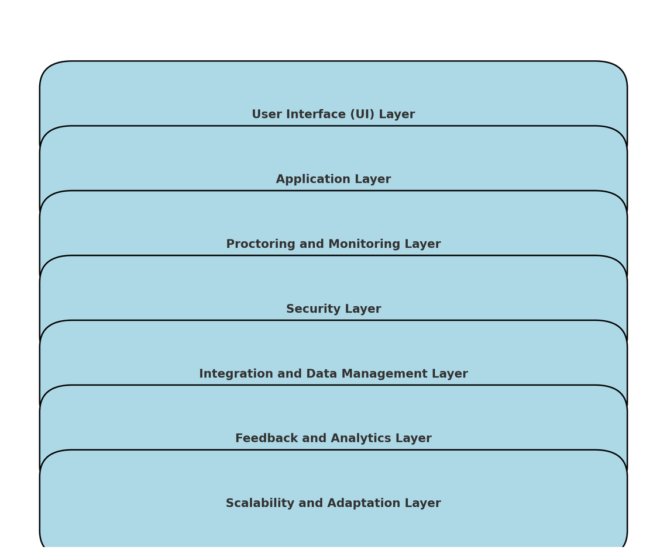
How it works
Functional Architecture

Slide 9
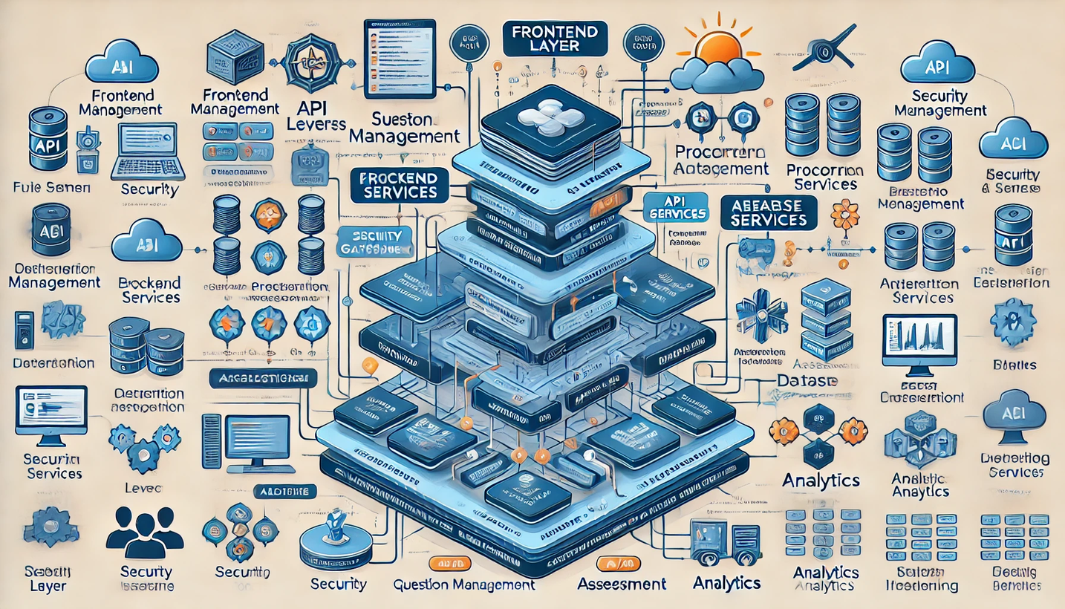
How It Works
Technical Architecture

Slide 10

10
Innovation and Creativity
A1. Adaptive Question Generation:
Innovation: Utilizes advanced Generative AI models like GPT-4 and T5 to automatically create diverse and contextually relevant questions. This ensures a wide variety of question types and difficulty levels, tailored to individual needs.
Creativity: Incorporates NLP algorithms to categorize questions by topic and difficulty, allowing dynamic and personalized assessments.
2. Real-Time Automated Feedback:
Innovation: Implements AI-driven feedback systems to provide immediate, personalized responses to student submissions, improving learning efficiency and engagement.
Creativity: Uses models like GPT-4 and GPT-Neo to generate detailed and context-aware feedback, which adapts to the student’s performance over time.
3. Enriched Content Creation:
Innovation: Employs Generative AI tools to automatically generate supplementary materials, such as explanations and examples, enhancing the quality and comprehensiveness of questions.
Creativity: Leverages T5 and BERT for crafting content that not only supports but enriches the assessment experience.
4. Advanced AI Proctoring:
Innovation: Integrates sophisticated AI algorithms for motion analysis and gaze tracking to ensure secure and fair examinations.Creativity: Uses AI to offer detailed proctoring insights, creating a comprehensive monitoring system that adapts to various examination environments.
5. Comprehensive Performance Analytics:
Innovation: Employs Generative AI for synthesizing performance metrics, trends, and actionable insights, enabling data-driven decision-making for both students and educators.
Creativity: Utilizes tools like GPT-J and XLNet to visualize and interpret performance data, presenting it in an intuitive and actionable format.
6. Personalized SWOT Analysis:
Innovation: Uses AI to assist students in performing SWOT analyses based on their performance data, providing tailored insights into their strengths, weaknesses, opportunities, and threats.
Creativity: Integrates ChatGPT and other generative tools to offer a dynamic and personalized analysis experience.
7. Future-Proof Adaptability:
Innovation: Designs the system to evolve with advancements in assessment technologies, ensuring its long-term effectiveness and relevance.
Creativity: Leverages adaptive learning models and Generative AI to continuously refine and improve assessment processes based on emerging trends and user feedback.

Slide 11
11
Scalability, Performance and Security
Scalability
To ensure scalability, the system makes use of scalable cloud platforms such as AWS, Azure, and Google Cloud, which enable it to easily handle increasing loads and user demands. It also leverages a microservices architecture, which modularizes components like question generation and feedback systems, allowing for seamless growth. Scalable databases, such as PostgreSQL and MongoDB, efficiently manage massive amounts of data, whereas load balancers distribute traffic evenly across servers to provide constant performance during peak periods.
Performance and Security
The system uses optimized AI models like GPT-4 and T5 for fast processing and low latency. Caching methods shorten response times for frequently accessed data, while parallel processing can perform large-scale computations efficiently. Performance monitoring solutions, such as New Relic or Datadog, continuously monitor system performance to resolve

Slide 12

12
Best practices and industry standards followed
The project adheres to industry best practices and standards to ensure high-quality delivery. It utilizes scalable cloud platforms (AWS, Azure, Google Cloud) and microservices architecture to handle increased loads and maintain flexibility.
Performance is optimized through efficient AI models, caching, and parallel processing, while real-time monitoring tools track system performance. Security measures include end-to-end encryption, robust access controls, and AI-driven proctoring systems, complemented by regular security audits to safeguard data and ensure compliance.
This comprehensive approach guarantees a reliable, high-performing, and secure assessment system.

Slide 13
12
Github Link
https://github.com/sheninthjr/The_X_Velammal_Inst

Slide 14
Thank You

